Slide 1
TEAM VASSP
Varnika Gupta
Arnav Gupta
Parth Mishra
Spandan Basu
Sreelakshmi S

Slide 2
KubeAI
Smart Remediation, Seamless Clusters
AI‑Driven Predictive Maintenance for Kubernetes & Beyond

Slide 3
Problem Statement
Modern IT infrastructures are complex and prone to failures arising from resource exhaustion (e.g., CPU spikes, RAM overuse), which can lead to significant downtime and financial losses. Traditional monitoring tools are largely reactive, identifying issues only after they have already impacted the system.
This project proposes an AI-powered predictive analytics system that proactively forecasts potential failures by leveraging historical logs and real-time performance metrics.
Key Features:
Early detection of critical risks and failure types
Interactive dashboard providing real-time operational insights
Optimized resource allocation for improved performance and efficiency
Minimized downtime and accelerated root-cause troubleshooting
By enabling proactive intervention, this system enhances infrastructure resilience and supports seamless operational continuity.

Slide 4
Our Solution
Developed an AI-driven predictive analytics system to detect and prevent IT infrastructure failures due to resource exhaustion (CPU, RAM, etc.).
Trained ML models on historical performance data to forecast potential failures before they occur.
Leveraged AI to analyse system behaviour, detect anomalies, and generate early failure warnings.
Implemented an interactive dashboard that displays real-time risk levels and failure types.
Enables IT teams to take proactive actions, optimize resource usage, and minimize downtime.
Bridges the gap between reactive troubleshooting and AI-powered predictive maintenance.
Improves system reliability, efficiency, and ensures uninterrupted operations in complex environments.

Slide 5
Advantages
🔍 Proactively predicts failures to avoid downtime and service disruptions
🧠 Uses AI to recommend smart fixes for pod, node, or resource-related issues
⚙️ Includes automated remediation with manual approval, ensuring control and safety
📊 Real-time dashboard shows health metrics, predictions, and alerts
⏱️ Reduces the need for manual monitoring, boosting productivity
💰 Improves cost-efficiency by preventing outages and optimizing

Slide 6
Disadvantages
Dependency on high-quality historical data: Poor or insufficient data can lead to unreliable predictions and outcomes.
Continuous model training and fine-tuning: The system needs regular updates to adapt to evolving infrastructure conditions, which can be resource-intensive.
Initial investment: Requires significant computational resources and seamless integration with existing IT systems.
Risk of false positives or inaccurate predictions: May lead to unnecessary interventions, potentially disrupting normal operations.
Need for skilled personnel: Experts are required to interpret AI-driven insights and implement appropriate actions, adding to implementation complexity.

Slide 7
Problems Solved
Addresses Critical Challenges: Tackles unexpected system failures in IT infrastructure caused by resource exhaustion (e.g., CPU and RAM overutilization).
Early Warnings & Accurate Predictions: Provides predictive insights to detect failures before they occur, minimizing downtime and performance issues.
Proactive vs Reactive Monitoring: Shifts from traditional reactive monitoring to proactive failure prevention.
Automated Detection & Risk Assessment: Reduces reliance on manual monitoring by automating failure identification and risk analysis.
Optimized Resource Allocation: Enhances operational efficiency by intelligently distributing resources based on predictive analytics.
Interactive Real-Time Dashboard: Offers real-time, actionable insights through an intuitive dashboard interface.
Improved Decision-Making: Empowers IT teams with data-driven tools to make informed decisions quickly.
Enhanced System Reliability: Minimizes disruptions and boosts the overall reliability of IT infrastructure.

Slide 8
Future Scope
Use deep learning for broader, more accurate failure predictions
Integrate with AWS, Azure, GCP for real-time cloud monitoring
Add anomaly detection & self-learning to improve model accuracy
Automate remediation actions to reduce manual intervention
Improve dashboard with advanced analytics & visual insights
Enable smart alerts with severity-based notifications
Support hybrid/multi-cluster infrastructure
Include security checks for misconfigurations & threats

Slide 9
Build Challenges
Sourcing clean, labeled Kubernetes failure data
Preprocessing noisy logs and handling missing metrics
Balancing prediction accuracy vs. false positives
Seamless integration with existing monitoring stacks
Securing sensitive infrastructure metrics and logs
Efficient deployment of AI models on Kubernetes
Managing real-time data flow across services
Automating CI/CD while ensuring system stability

Slide 10
Target Audience
DevOps Engineers – To automate failure detection and remediation
SRE (Site Reliability Engineers) – For improving infrastructure resilience
Cloud Architects – To design scalable, self-healing systems
IT Operations Teams – For real-time monitoring and proactive management
Enterprises with Large-Scale Kubernetes Deployments
AI/ML Researchers – Interested in predictive maintenance and anomaly detection
Organizations with High Uptime Requirements – Finance, Healthcare, E-commerce

Slide 11
Technologies Used
FRONTEND
React.js
Tailwind CSS
Recharts
React Router
Framer Motion
Fetch API
BACKEND
Python
Flask
Flask-CORS
nbformat
JSON
OTHER TECH
Jupyter Notebook
Machine Learning (Scikit-learn)
Matplotlib
NumPy
Pandas
Git & GitHub

Slide 12
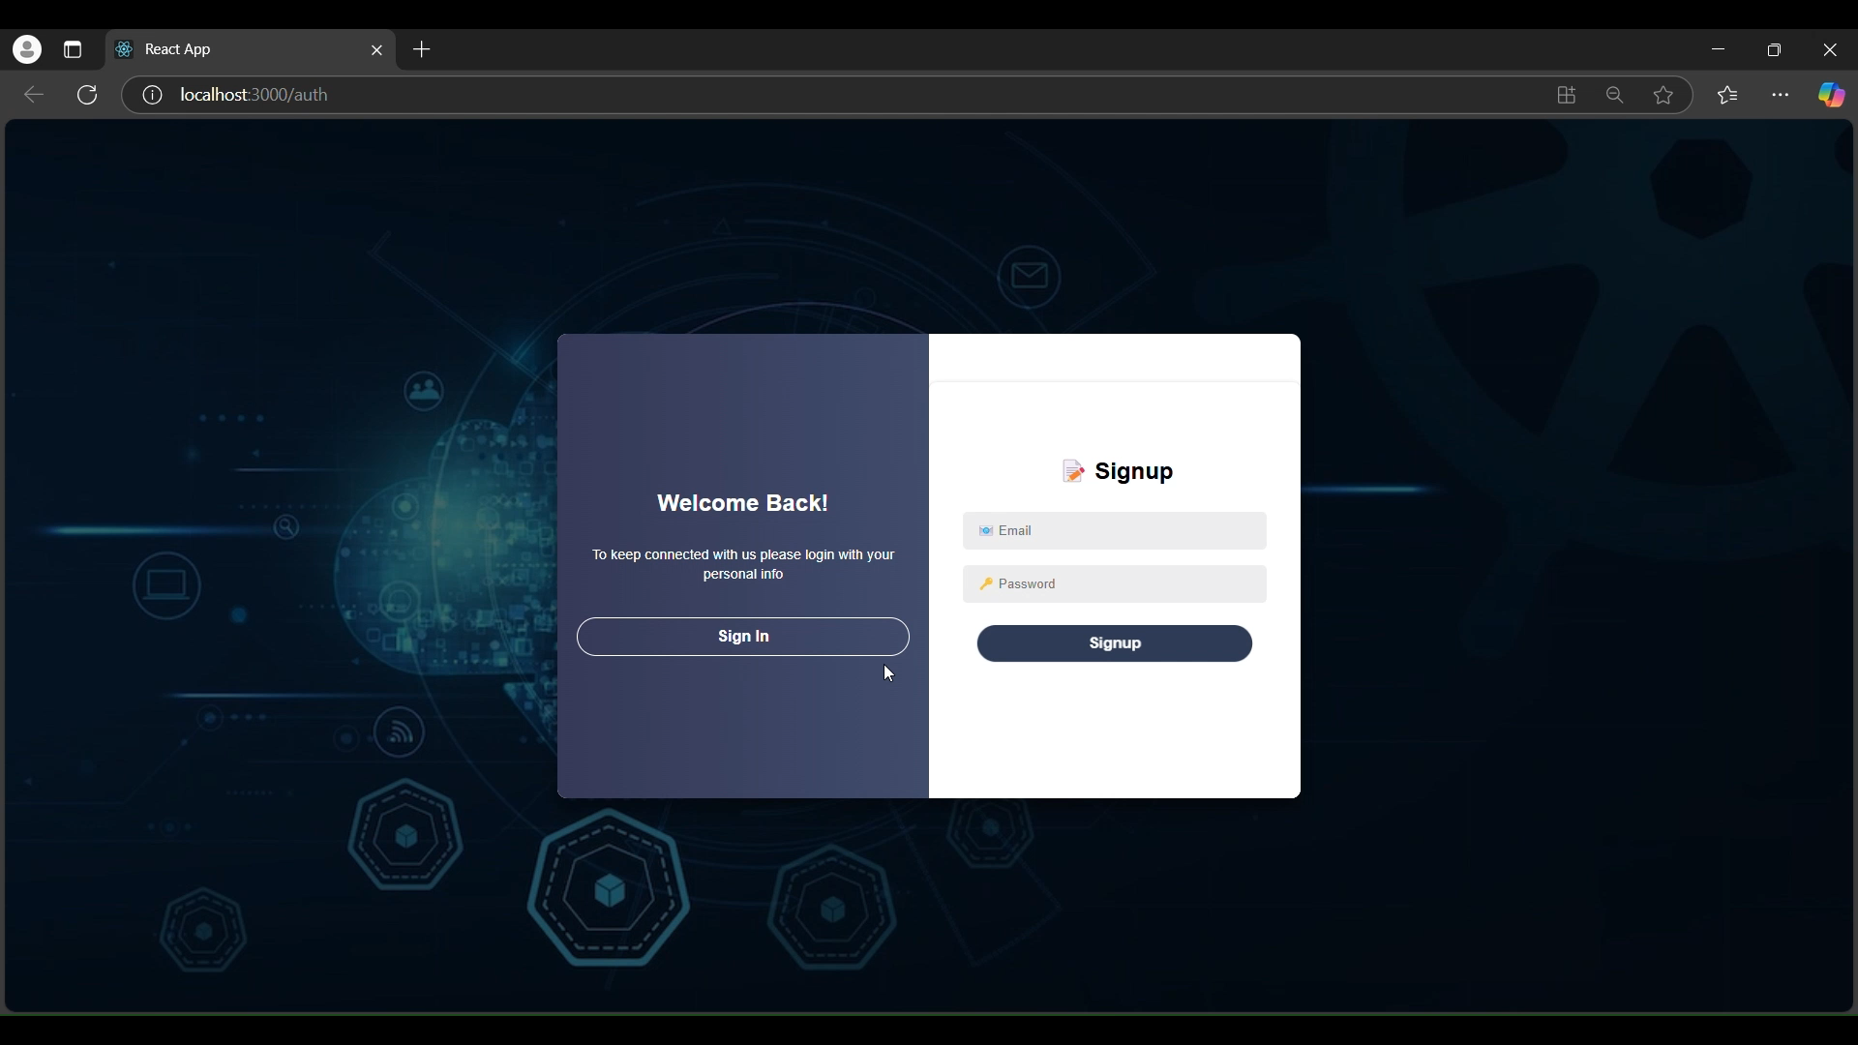
Implementation

Slide 13
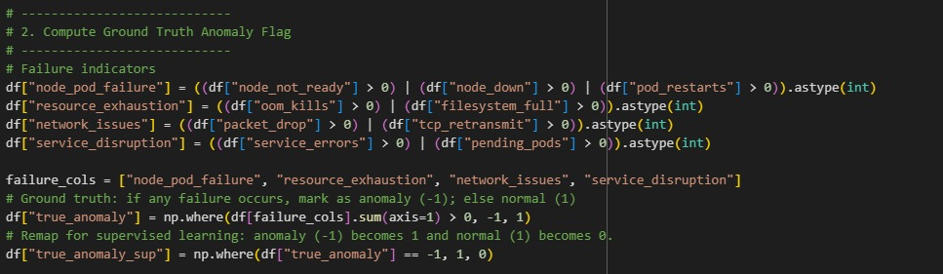
Implementation

Slide 14
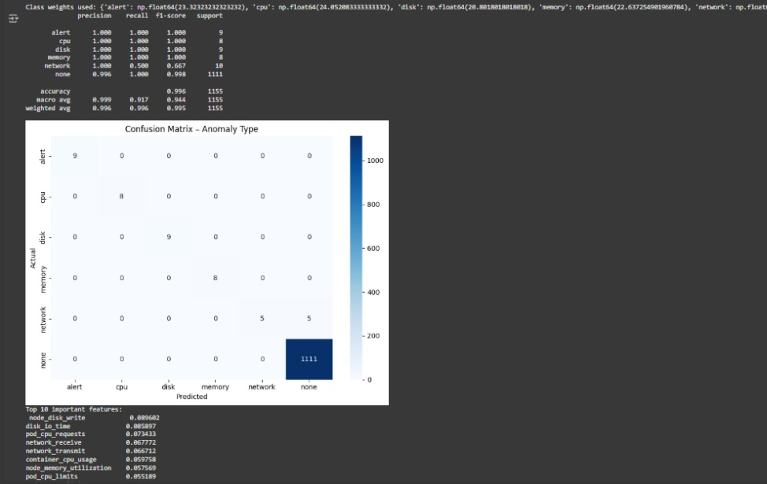
Confusion Matrix

Slide 15
THANK YOU

